Slide 1
Spotify predictions
Dor Azaria
Egor Kononov​​

Slide 2

topics
Popularity Prediction
Mood Prediction (Happy, Sad, Romanic, Chill)

Slide 3
Reasons to predict
Popularity
Mood
Commercial
Financial
Musical
Therapy
Social Mental State

Slide 4
The dataset
Spotify Dataset 1921-2020, 160,000 Track
Primary:
id (Id of track generated by Spotify)
Numerical:
acousticness (Ranges from 0 to 1)
danceability (Ranges from 0 to 1)
energy (Ranges from 0 to 1)
duration_ms (Integer typically ranging from 200k to 300k)
instrumentalness (Ranges from 0 to 1)
valence (Ranges from 0 to 1)
popularity (Ranges from 0 to 100)
tempo (Float typically ranging from 50 to 150)
liveness (Ranges from 0 to 1)
loudness (Float typically ranging from -60 to 0)
speechiness (Ranges from 0 to 1)
year (Ranges from 1921 to 2020)
Dummy:
mode (0 = Minor, 1 = Major)
explicit (0 = No explicit content, 1 = Explicit content)
Categorical:
key (All keys on octave encoded as values ranging from 0 to 11, starting on C as 0, C# as 1 and so on…)
artists (List of artists mentioned)
release_date (Date of release mostly in yyyy-mm-dd format, however precision of date may vary)
name (Name of the song)

Slide 5
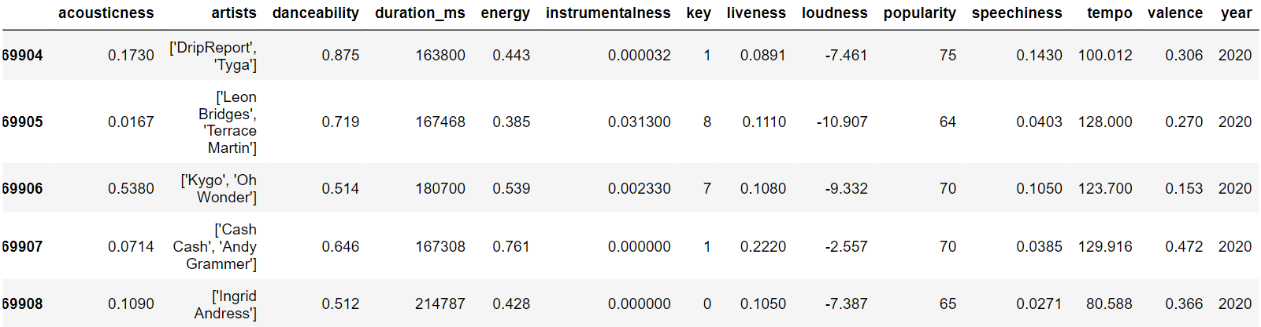
The dataset

Slide 6
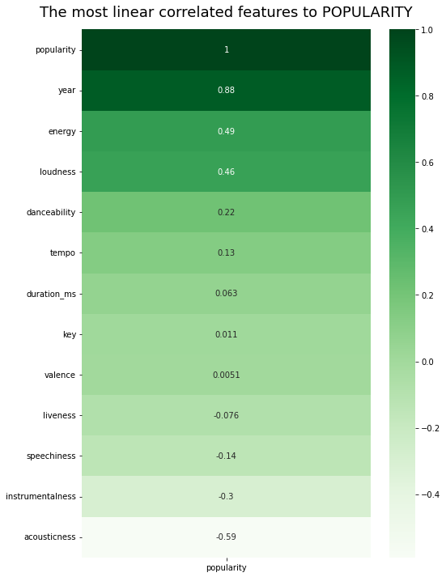
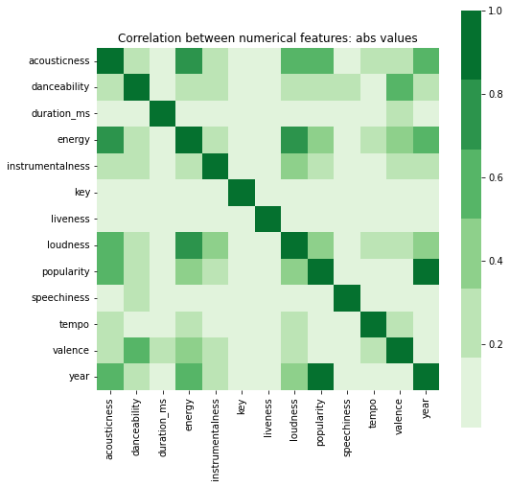
EDA – POPULARITY PREDICTION
At the beginning of the data analysis, we checked the correlations
MATRIX CORRELATION

Slide 7
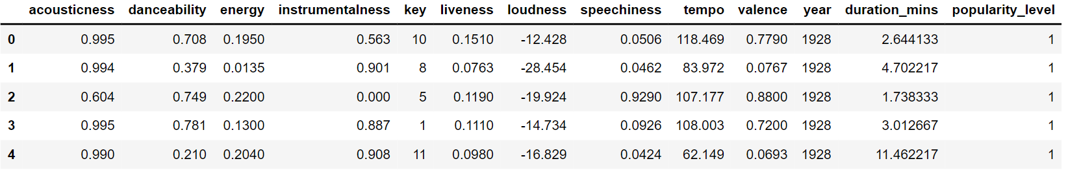

POPULARITY PREDICTION
Preparation
Popularity Range:
$0≤Popularity≤30→1$
$30<Popularity≤60→2$
$60<Popularity≤100→3$

Slide 8
models
The five algorithms we chose to use in the data set analysis:
Decision Tree
Nearest Neighbors Classifier
Logistic Regression
AdaBoost Classifier
Random Forest Classifier

Slide 9
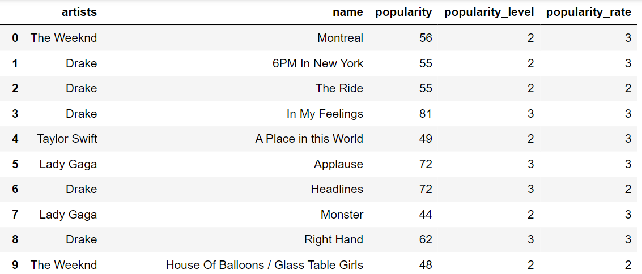
POPULARITY PREDICTIONS RESULTS
Algorithm | Accuracy
Decision Tree | 0.745427
Nearest Neighbors Classifier | 0.79367
Logistic Regression | 0.575765
AdaBoost Classifier | 0.77481
Random Forest | 0.807188

Slide 10
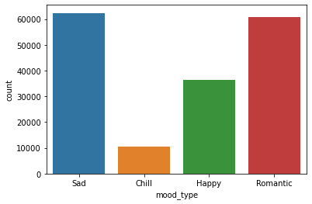
mood PREDICTION
Classifying Moods using K-Means Clustering
With everything gathered into a neat dataset, the next step was to “cluster” the songs into different groups based on their similarities in mood.
The chosen group containing values for danceability, energy, loudness, acousticness, and valence.
Cluster 0: “Happy”
Cluster 1: “Romantic”
Cluster 2: “Chill”
Cluster 3: “Sad”
Counter of each mood type

Slide 11
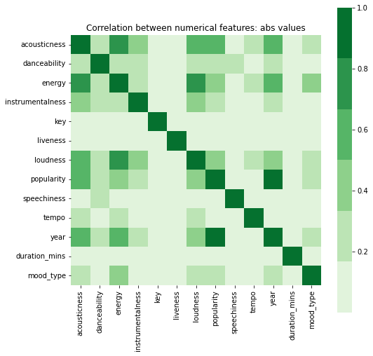
EDA – mood PREDICTION
At the beginning of the data analysis, we checked the correlations
MATRIX CORRELATION

Slide 12
models
The five algorithms we chose to use in the data set analysis:
Decision Tree
Nearest Neighbors Classifier
Logistic Regression
AdaBoost Classifier
Random Forest Classifier

Slide 13
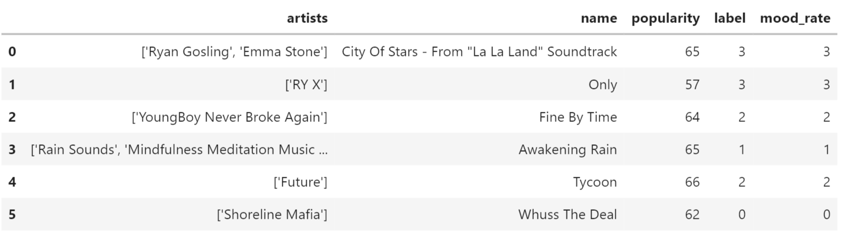
POPULARITY PREDICTIONS RESULTS
Algorithm | Accuracy
Decision Tree | 0.999129
Nearest Neighbors Classifier | 0.996422
Logistic Regression | 0.956589
AdaBoost Classifier | 0.933071
Random Forest | 0.999459

Slide 14
Summary
RESULTS
Popularity best prediction model is Random Forest with 0.807188
Mood best prediction model is Random Forest with 0.999459
NOTES
Data processing was performed on a dataset before use
The categories have been replaced by numbers
CHALLENGES
Deciding which model, we should use
Divide the popularity into levels
Understanding the need for K-Means clustering
SOURCES
Mood ring – medium.com
Kaggle Dataset

Slide 15



Thank you
Project by
GITHUB
Popularity Prediction
Mood
Prediction
Dor Azaria
Egor Kononov

